Slide 2
Watch video in next slide and answer following questions:
What inspired you?
What challenged you?
What are you going to do about it?

Slide 3
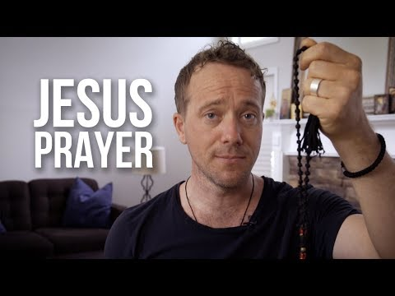

Slide 4
Watch video in next slide, gather supplies, and make your own simple prayer rope!
Pray! Rewatch first video if you need to remember the prayer and why we pray it
Make another simple prayer rope for someone else and teach them to pray the Jesus prayer, too!

Slide 5
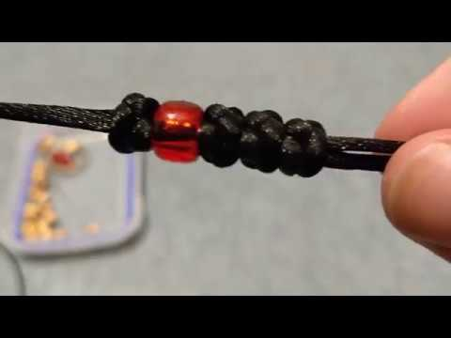

Slide 6
